Slide 1
CORAL VER2
VERSION: A0
DATE: 28/12/2017

Slide 2
Main issues
Project details and Supplies
Expected and required changes and Upgrades

Slide 3
Order deliverables
Changes | Main notes | Abroad | Local | Unit
Wide Band Testability option Mech ( Nut Lock ) | 5675 – 5875MHz | V |  | BA-CB-TX5-SYS-HWT
Wide Band Testability option Mech ( Nut Lock ) Improve Ip1dB | 5675 – 5875MHz | V |  | BA-CB-RX18-SYS- HWHT
Mech ( Nut Lock ) ?? | 5150 – 5250MHz |  | V | BA-CB-TX5-SYS-L
Mech ( Nut Lock ) ?? | 5150 – 5250MHz |  | V | BA-CB-RX18-SYS- L

Slide 4
Current System
Tx Power : 37dBm
Tx Antenna: 9.5dB
Rx antenna : 18dBi
Frequency: 5.725 – 5.825GHz
7MHZ BW
No Tx Near RX

Slide 5
New System
Freq: 5675 – 5875MHz
Additional connection between site 1 and 2
3 Systems in same area
Scenario
3 new systems
Old system ( + additional Site 1-2 connection ) + 1 new system ( request that highest frequency will be 5850MHz)

Slide 6
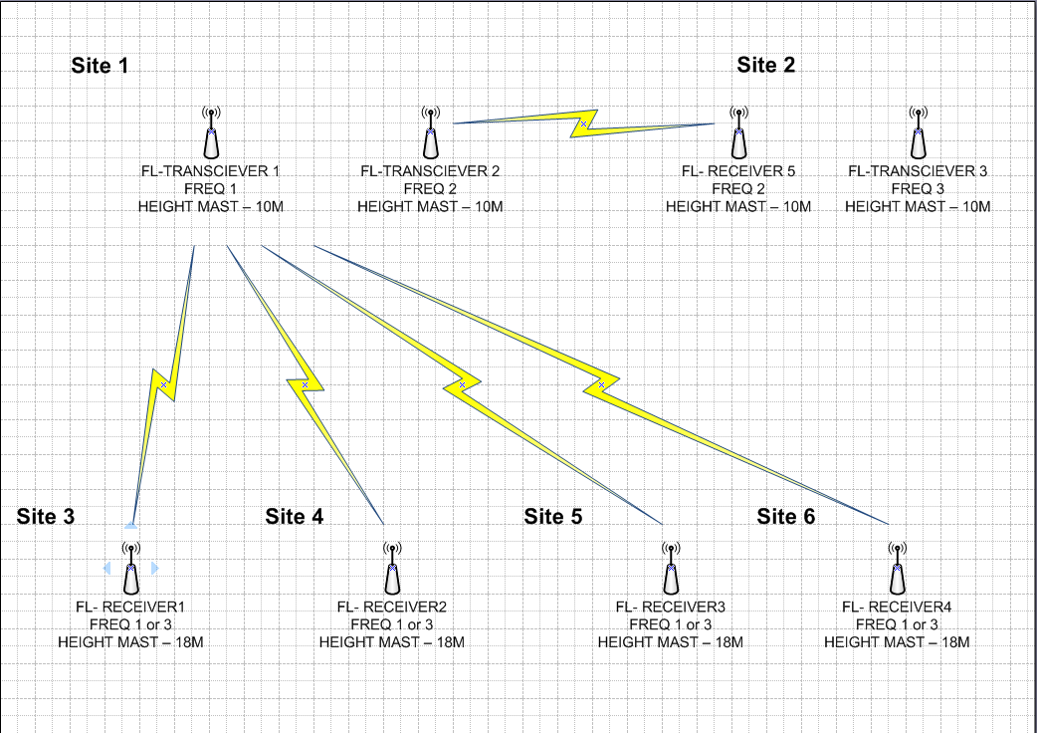
Frequency allocation Consideration
Rx IP1dB is~ -30dBm
Tx Rx antenna isolation is >50dB
Receiver selectivity:
20MHz →50dB
40MHz → 90dB

Slide 7
Freq Allocation Suggestion
In Old System Range

Slide 8
Combining New and Old
NEW

Slide 9
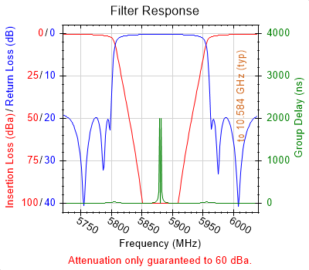
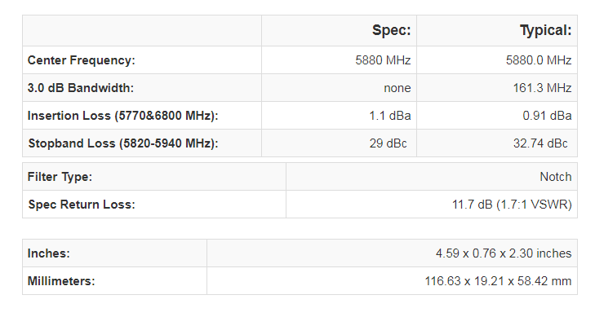
Additional NOTCH Filter
The RX in the new system require a Notch filter ( For Example)
In opreder for Rx not to be “ specific For sit 2” a Bypass Switch Is needed.
Affecting Sensitivity in <2dB

Slide 10
System drawbacks
All The Site 2 Transmitters have to be set to above 5820MHz
The RX in site 2 has to have a Notch Filter
If we Can increase Rx Ip1dB we can allow a more flexible solution.
Increase IP1dB up to ~ 0dBm

Slide 11
Increase IP1dB
Re Design Rf Front END
Need IP1dB of ~0dBm
NF Increase By ~ 4-5dB
In this case 40MHz Separation needed
Not replaceable with older unit

Slide 12
Bit Option

Slide 13
Required Functions
BIT of The link
Stop transmitting through Serial command
1w Output power
It is important to keep the low latency of the link!!

Slide 14
Current Status
Data and Control are split into two Paths
Data does not pass through digital processing
This should also be the case with any system

Slide 15
Offered Solution
Mux on transmitter to select data .
On Rx the unit is only Listening

Slide 16
Painting Procedure

Slide 17
Painting
color: Dark Green Lusterless no. 34052 per FED STD 595
Radom Painting Procedure
- 1st step: Cleaning the surface with extra fine grade grinding sponge.
- 2nd step: Cleaning the surface with chemical cleaner solvent.
- 3rd step: Painting with EPOXY CHROMATE FREE Primer meeting MIL-PRF-53022 30-50 mic.
- 4th step: Undercoat Painting EPOXY POLYAMID PER MIL-PRF-22750G Type II 24533 - Seafoam Green.
- 5th step: Top coat Painting polyurethan per MIL-PRF-85285E Type II Class H Dark Green 34052. (UV protect

Slide 18
PAINTING-OUR OFFER
We are Afraid for antenna performance.
We would like to do :
polyurethane only paint system (no primer), where the plastic radomes is treated to accept the top coat

Slide 19
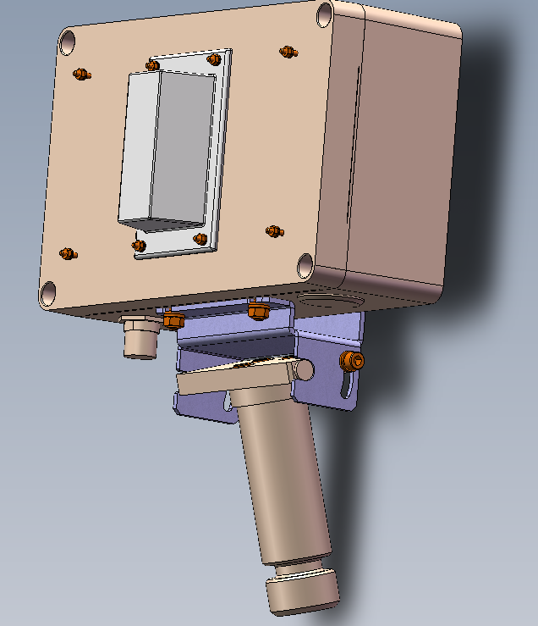
Turning in the up/Down direction

Slide 20
Summary of Changes

Slide 21
Changes in Unit -Tx
Tx
Should support 200MHz Band
Replace PA Unit ( Need to Fix Power supply)
Internal filter fix
Replace output Filter
Sw update
Internal Bit
Add CPLD
Additional Functionality for BIT
Option: Measure Voltage , temperature, Current?
Paint

Slide 22
Changes in unit - Rx
Rx
Should support 200MHz Band
Fix internal filters
Fix Input BPF
Add Notch filter
Sw update
Internal Bit
Add CPLD
Additional Functionality for BIT
Option: Measure Voltage , temperature, Current?
Paint

